Slide 2
AUTOMATING A NUIX DEV ENVIRONMENT
Drew Nase
Integrated Solutions Architect - Nuix

Slide 3

INTRODUCTION
Hi, I’m Drew.
I have been developing software for over twenty years (professionally for about fifteen). I am a member of the Integrated Solutions Team at Nuix.

Slide 4
WHAT DO WE MEAN BY “AUTOMATION”?
Mindset - Never do anything manually twice.
Computers are really fast, but really dumb.
They excel at tedious tasks.
Configuring a system is tedious, and humans don’t need to be involved more than once.
Stay DRY (Don’t Repeat Yourself). Don’t get WET (Write Everything Twice).
boxes = ['drew', 'laura', 'nate'] Vagrant.configure("2") do |config| boxes.each_with_index { |boxname, idx| config.vm.define boxname config.vm.network :private_network, ip: "10.0.42.#{idx}" config.disksize.size = '200GB' config.vm.box = "ubuntu/xenial64" config.vm.hostname = "#{boxname}-dev.nuix.com" config.vm.provider :virtualbox do |vb| # CPU, memory vb.customize ["modifyvm", :id, "--cpus", "2"] vb.customize ["modifyvm", :id, "--memory", "8096"] end

Slide 5
WHAT DO WE MEAN BY “AUTOMATION”?
Infrastructure as code
“Infrastructure as code (IaC) is the process of managing and provisioning computing infrastructure (processes, bare-metal servers, virtual servers, workstations, etc.) and their configuration through machine-processable definition files, rather than physical hardware configuration or the use of interactive configuration tools.“
#this is Puppet code that configures Elastic include ::java class { 'elasticsearch': } $instance_name = "es-${::hostname}" elasticsearch::instance { $instance_name: config => { 'network.host' => $::networking['interfaces']['enp0s8']['ip'], } }

Slide 6
WHY AUTOMATE?
Developing in production is bad, mmmkay?
INSERT MR. MACKEY HERE
But…
Keeping production and development environments in sync is hard
Time spent maintaining dev environments is time taken away from product development

Slide 7
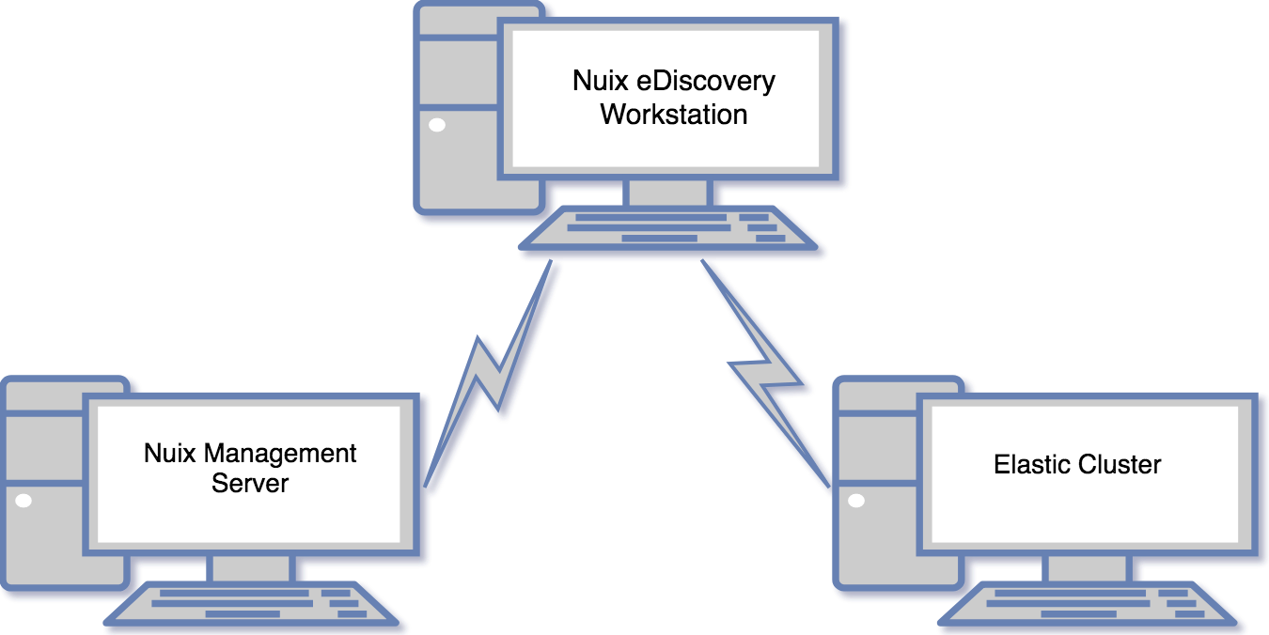
PRODUCTION ENVIRONMENT

Slide 8
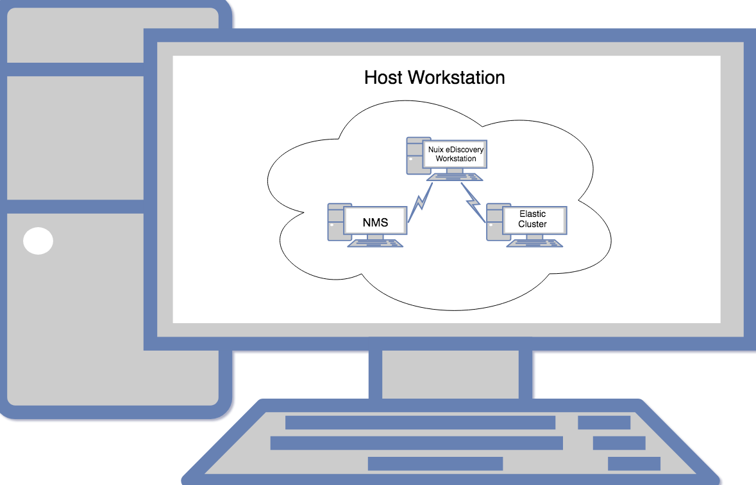
VIRTUAL DEV
ENVIRONMENT

Slide 9
GENERAL WORKFLOW OVERVIEW
Provision VMs with Vagrant
Configure VMs with Puppet, scripts, and manually where necessary
Package fully configured VMs with `vagrant package` - optionally, use a build tool like Jenkins here
Maintain VMs as code with version control, iterating on steps 1-3
Notes:
These steps are just a general outline, and there are plenty variations on this type of development pipeline that will work perfectly well.

Slide 10
Practical Demonstration

Slide 11
SUMMARY
Automating your Nuix development pipeline
Increases predictability and reliability of your development environment
Decreases time spent maintaining your development environment
Decreases time from development to deployment
Reduces the risk of a production outage due to a bad deployment
Code from demos available here:
https://github.com/dnase
https://github.com/Nuix

Slide 12
Questions?

